Slide 1
Psychology II
Day 2- February 5, 2016

Slide 2
Day 2 Journal Response
What happened when Charlie was given the Thematic Apperception Test?
Who was Algernon? Describe Charlie’s first meeting with him.
What was Professor Nemur worried about with regard to the operation?
Why did Charlie want to be smart?
What was Mr. Donner’s relationship with Charlie?

Slide 3
Learning Target:
I can explain why adolescence is a time of stress and change for adolescents, their families, and their peers.

Slide 4
Social Development & Adolescent Brain
Remember—you are a work in progress! That includes your brain.
Longitudinal studies show the brain keeps developing until the early 20s
Prefrontal cortex=brain’s CEO
Risk taking behaviors and social forces driving decision-making

Slide 5
Quick Check:
How adept are you at understanding the emotions of others? Facial expressions provide clues to our cognitive and social development.
Let’s see if your cognitive and social development are at the level researchers now expect.

Slide 6
What emotion do you think you see?
Correct answer: anger

Slide 7
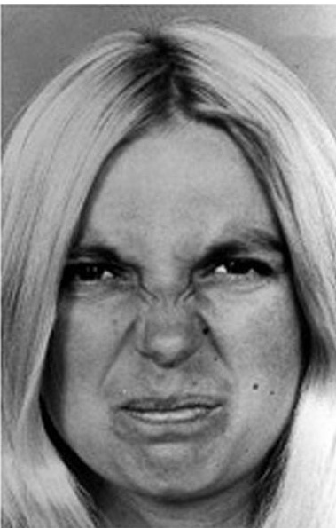
What emotion do you think you see?
Correct answer: disgust

Slide 8
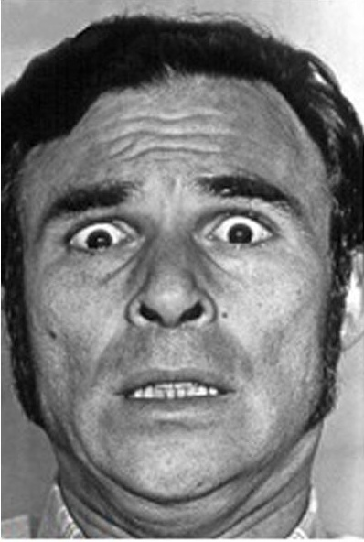
What emotion do you think you see?
Correct answer: fear

Slide 9
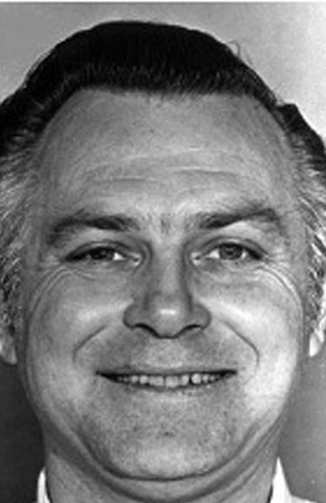
What emotion do you think you see?
Correct answer: happiness

Slide 10
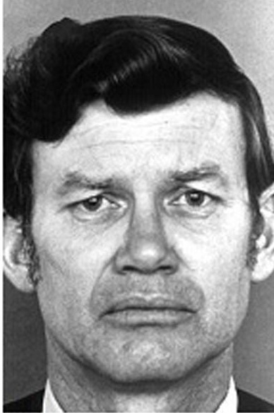
What emotion do you think you see?
Correct answer: sadness

Slide 11
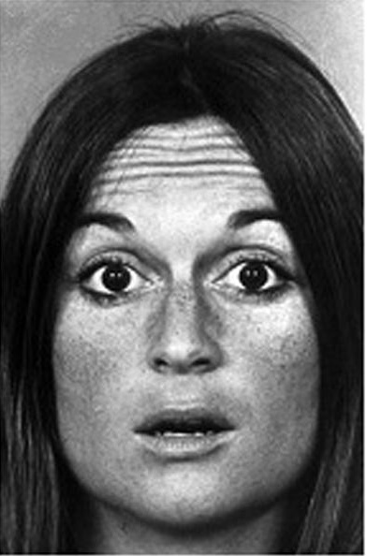
What emotion do you think you see?
Correct answer: surprise

Slide 12
Results
Teens on average responded inaccurately to the facial expressions 50% of the time
Adults (over 21 years of age) responded correctly 100% of the time
Younger teens were even less likely than older peers to respond accurately

Slide 13
Sturm und Drang
German expression used to describe the period of adolescence
Social distress is tied to biological changes
Combination of both biological (hormones) and social (peer influence) factors
Most teenagers come out of the chaos OK- more friends, new knowledge, better social skills

Slide 14
Relationships with Parents
Conflict exists, but outcomes often positive
Adolescent “quest for independence” i.e.: greater freedom of choice and action
Better parent bonds=easier adjustment to late adolescence/early adulthood
Typically, more interaction with and trust of mother

Slide 15
Relationships with Peers
Peers become more important in social decision-making
Think back- What did Dr. Zimbardo say about the differences between friendships among girls & friendships among boys?
Cliques- groups of 5-10 people with similar interests and strong social bonds
Crowds- large groups of people with similar identity but weaker social bonds
Dating among peers develops and changes with age and developmental level

Slide 16
How are adolescents perceived?

Slide 17
Did we hit our Learning Target?
I can explain why adolescence is a time of stress and change for adolescents, their families, and their peers.

Slide 18
For next time:
Read progress report 9 in Flowers for Algernon and be prepared to answer questions 6-10 on the journal sheet.
Don’t forget to bring your book for 25 points!

